Slide 1

Business in a Globalized World
Chapter 4
Copyright ©2020 McGraw-Hill Education. All rights reserved. Authorized only for instructor use in the classroom. No reproduction or further distribution permitted without the prior written consent of McGraw-Hill Education.

Slide 2

The Process of Globalization
What is Globalization?
Developing global market channels
Establishing global operations
Developing global supply chains
Notes:
Globalization: the increasing movement of goods, services, and capital across national borders.
A process – an ongoing series of interrelated events:
International trade and financial flows integrate the world economy, leading to the spread of technology, culture, and politics.
Globalization is not simply a trend or a fad but, rather, an international system.
Develop global market channels:
First build a successful business in their home country, then export products or services to buyers in other countries.
→ Example: Nestlé, PayPal.
Establish global operations:
Locate manufacturing plants or service operations in other countries as a way to cut costs.
Example: BMW.
Develop global supply chains:
Purchase raw materials, components, or other supplies from sellers in other countries; work may also be subcontracted.
→ Example: Nike, Gap.
Summarized in 3 words:
Sell.
Make.
Source.

Slide 3

Major Multinational Enterprises (MNEs)
Defined by the United Nations as firms that control assets abroad.
Most global commerce is carried out by a small number of powerful firms.

Slide 4
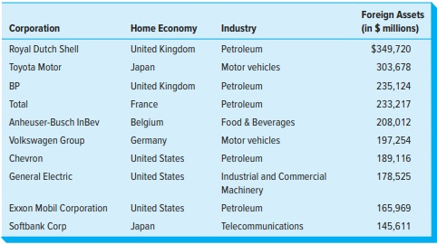
The World’s Top 10
Nonfinancial Multinational Enterprises
Figure 4.1
Copyright © McGraw-Hill Education. Permission required for reproduction or display.
Access the text alternative for these images.

Slide 5

Consider
Foreign Direct Investment (FDI)
Inversion
Notes:
Another important aspect of globalization is the worldwide flow of capital.
FDI occurs when a company, individual, or fund invests money in another country, for example, by buying shares of stock in or loaning money to a foreign firm.
In 2016, FDI was $1.75 trillion.
Companies avoid taxes in their home countries:
by merging with companies located in other countries and shifting their headquarters there.
A strategy of acquiring or merging with a foreign firm in order to reduce corporate tax obligations at home.
→ Example: Burger King.

Slide 6
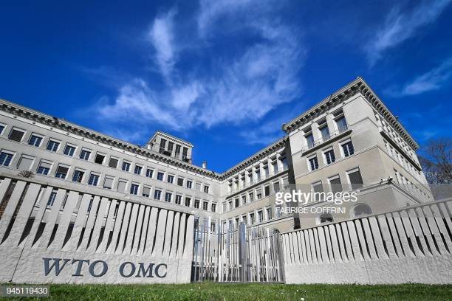
International Financial and Trade Institutions
Three institutions that set the rules by which international commerce is transacted:
  World Bank (WB).
  International Monetary Fund (IMF).
  World Trade Organization (WTO).
Notes:
No business can operate across national boundaries without complying with rules set by the WTO.
Many businesses in developing countries are dependent on WB and IMF loans to survive.

Slide 7
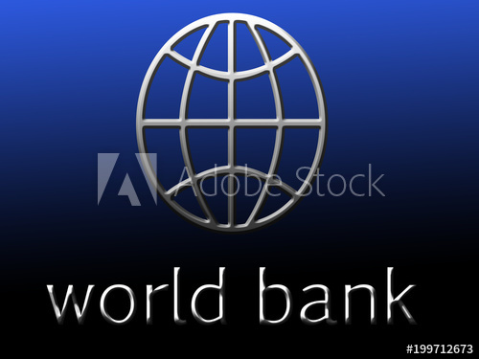
A closer look at..
The World Bank
International Monetary Fund
World Trade Organization
Notes:
World Bank: Established in 1944. Provides economic development loans to its member nations.
Funds used mainly for roads, dams, power plants, and other infrastructure projects, as well as for education, health and social services.
Funding provided by member countries and international capital markets.
International Monetary Fund: “Sister” organization to World Bank, created at same time.
Purpose: to stabilize the system of currency exchange rates and international payments to enable member countries to participate in global trade.
Lends foreign exchange to member countries.
Imposes conditions on governments that receive its loans. These conditions often lead to hardship:
Demands that governments cut spending.
Devalue their currencies.
Increase exports.
Liberalize financial markets and reduce wages.
World Trade Organization: Founded in 1995, successor to General Agreement on Tariffs and Trade (GATT).
International body that establishes the ground rules for trade among nations.
Its major objective is to promote free trade; attempts to eliminate barriers to trade (e.g. quotas, duties and tariffs).
Conducts “rounds” of negotiations on various topics.
“Most favored nation” rule means members countries cannot discriminate against foreign products for any reason.

Slide 8
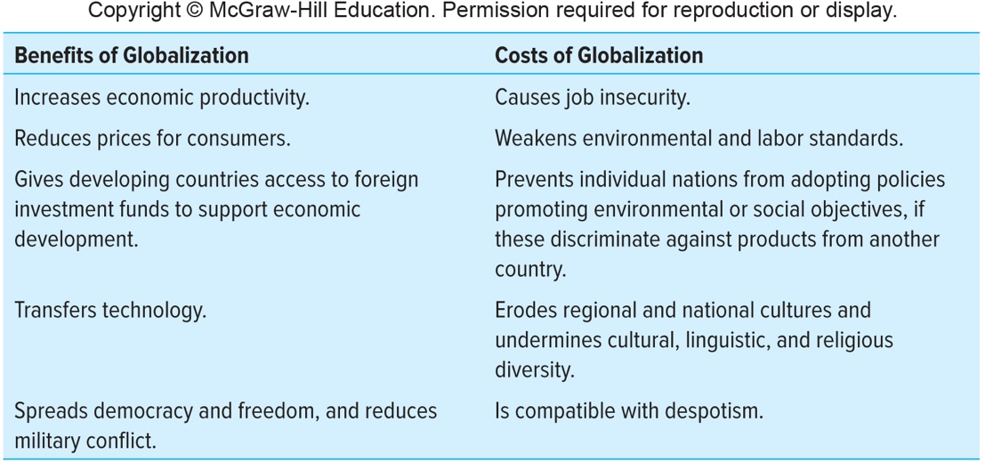
The Benefits and Costs of Globalization2
Figure 4.2
Copyright © McGraw-Hill Education. Permission required for reproduction or display.
Access the text alternative for these images.
Notes:
Globalization is highly controversial.
Clearly, some benefit from globalization, while others do not.
What are some of the major arguments advanced by both sides in the debate over this important issue?

Slide 9
Comparative Political Systems1
Democracy – The presence of political freedom.
Four defining features of democracy (according to the U.N.):
Independent media
Fair elections
Separation of powers
among the executive, legislative, and judicial branches of government
An open society where citizens have the right to form their own independent organization
Notes:
Consider different leaders/dictators from the past and how they, often through deception manage and manipulate the four factors.
Democracy has declined in the 21st century. According to Freedom House estimates:
25 percent of countries are "not free.“
another 30 percent are only "partly free“.

Slide 10
Comparative Political Systems3
Degree to which human rights are protected differs greatly among nations.
Several international codes of human rights exist.
Still, many violations of human rights continue to occur:
Notes:
Degree to which human rights are protected differs greatly among nations.
Several international codes of human rights exist.
United Nations Universal Declaration of Human Rights of 1948.
Over half world’s nations have adopted these human rights covenants.
Still, many violations of human rights continue to occur:
More than 5 million children die each year before their fifth birthday due to pneumonia, diarrhea, malaria, and other.
Systems where minority groups and indigenous peoples lack basic human rights, e.g., the status of “untouchables” in Nepal.
In 2017 25 million people worldwide were victims of forced labor, trafficking, and human slavery.
Genocide, the mass murder of innocent civilians, e.g., in Syria, Rwanda.

Slide 11
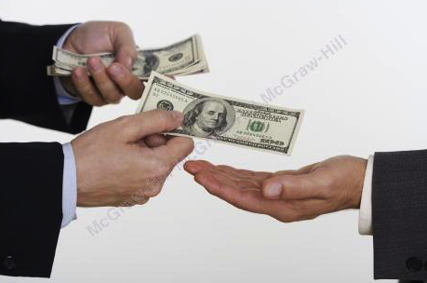
Comparative Economic Systems
Free enterprise systems
Central state control
Notes:
Free enterprise systems
Based on the principle of voluntary association and exchange.
Members of society satisfy most of their economic needs through voluntary market transactions.
Central state control
Economic power is concentrated in the hands of government officials and political authorities.
The central government owns the property that is used to produce goods and services.

Slide 12
The Heritage Foundation
Has scored the nations of the world according to an Index of Economic Freedom: the fundamental rights of every human being to control his or her own labor and property.
  Among the freest nations in 2018: Hong Kong, Singapore, and Canada.
  Among the most repressed were Iran, Venezuela, and—the least free in the world—North Korea. The United States ranked 48th out of 183 countries.

Slide 13
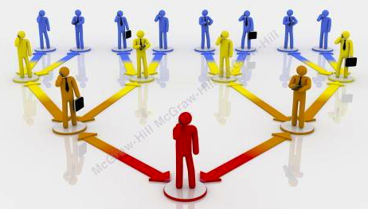
Global Inequality and the Bottom of the Pyramid1
Inequality
Wealth
Income
Notes:
Inequality may be measured in two ways: by wealth and income.
Wealth refers to assets that a person accumulates and he or she owns at a point in time.
Income represents how much a person earns in a day or a year.

Slide 14
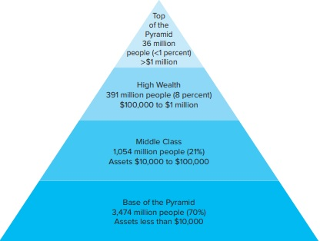
Global Inequality and the Bottom of the Pyramid2
Global Wealth Pyramid
Figure 4.3
Copyright © McGraw-Hill Education. Permission required for reproduction or display.
Access the text alternative for these images.

Slide 15
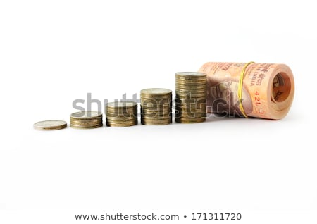
Consider
Global Inequality and the Bottom of the Pyramid3
Microfinance
Collaborative Partnerships for Global Problem Solving
Notes:
Bottom of the pyramid refers to individuals earning below $3000 a year in local purchasing power. Focusing on the bottom of the pyramid can foster:
Social development.
Provide employment in underserved communities.
Reap profits.
Microfinance: This occurs when financial organizations provide loans to low-income clients or solidarity lending groups (a community of borrowers) who traditionally lack access to banking or related services.
→Examples:
Grameen Bank in Bangladesh.
Indonesia, a midsized bank called BTPN.
Emerging trend for development of collaborative, multi-sector partnerships focused on particular social issues or problems in the global economy.
These partnerships have been termed global action networks, or GANs.
Involves 3 sectors: Business, Government, and Civil Society
Civil society comprises nonprofit, educational, religious, community, family, and interest-group organizations.

Slide 16
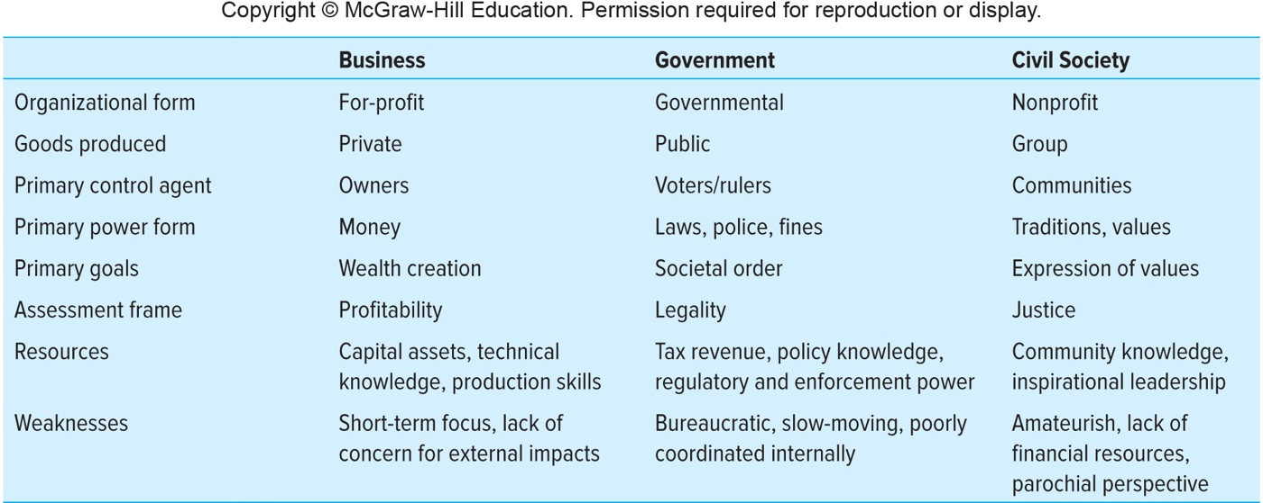
Distinctive Attributes of the Three Major Sectors
Figure 4.4
Copyright © McGraw-Hill Education. Permission required for reproduction or display.
Access the text alternative for these images.

